Slide 1
Complex Problem Azlan Abdul Aziz Universiti Putra Malaysia (Academic Advisory Panel & Former Director, EAD, BEM; IEA WA Mentor for PEC)
2-Day Workshop on OBE System, 2018
Pakistan

Slide 2
PO Attainment
Final Year Project
Final Year Project
Final Year Design Project
Final Year Design Project
Final Year Courses
Final Year Courses
Knowledge | Skills | Affective
Third Year Courses
Third Year Courses
Second Year Courses
Second Year Courses
Knowledge | Skills | Affective
First Year Courses
First Year Courses

Slide 3
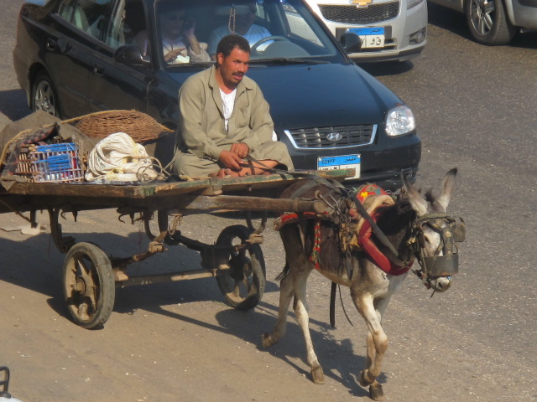
Taxonomy & Course Outcome

Slide 4
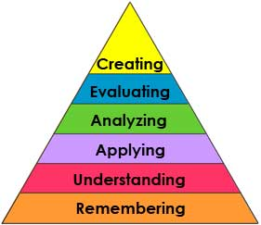
New Bloom’s Taxonomy
Bloom’s Taxonomy
Knowledge (list)
Comprehension (explain)
Application (calculate, solve, determine)
Analysis (classify, predict, model,derived)
Synthesis (design, improve)
Evaluation (judge, select, critique)

Slide 6
lower order
Intermediate
Higher order

Slide 7
lower order
Intermediate
Higher order

Slide 8
Learning outcomes by adding a condition and standard
Open Ended (O.E.)
Students should be able to design research.
Moderately O.E. with condition
Students should be able to independently design and carry out experimental and correlational research.
Constrained by condition & standard
Students should be able to independently design and carry out experimental and correlational research that yields valid results.
Source: Bergen, R. 2000. A Program Guideline for Outcomes Assessment at Geneva College

Slide 9
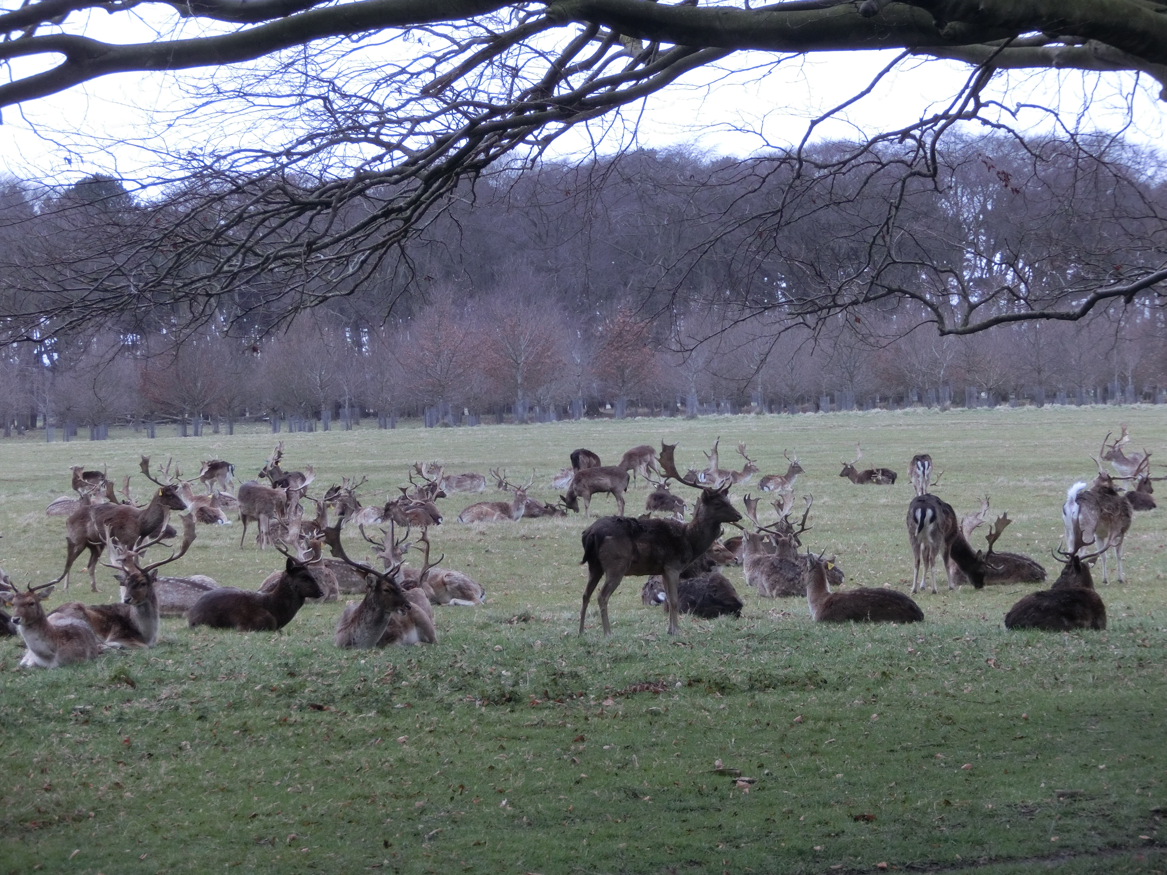
Knowledge Profile (WK)

Slide 10
Knowledge Profile
WK1
natural sciences
WK5
engineering design
WK2
mathematics, numerical analysis, statistics, computer and information science
4 YEARS
WK6
engineering practice
WK7
engineering in society
WK3
engineering fundamentals
WK4
engineering specialist knowledge
WK8
research literature

Slide 11
Knowledge Profile (Curriculum)
Theory-based natural sciences | WK1
Conceptually-based mathematics, numerical analysis, statistics and formal aspects of computer and information science to support analysis and modelling | WK2
Theory-based engineering fundamentals | WK3
Engineering specialist knowledge that provides theoretical frameworks and bodies of knowledge for the practice areas; much is forefront | WK4

Slide 12
Knowledge Profile
Knowledge that supports Engineering design in the practice areas | WK5
Knowledge of Engineering practice (technology) in the practice areas | WK6
Comprehension of the role of Engineering in society and identified issues in engineering practice: ethics and professional responsibility of an engineer to public safety; the impact of engineering activity: economic, social, cultural, environmental and sustainability | WK7
Engagement with selected knowledge in the Research literature | WK8

Slide 13
Programme Outcome (WA)

Slide 14
Washington Accord Graduate Attributes PROGRAMME OUTCOMES
WA1 | Engineering Knowledge | Breadth & depth of knowledge
WA2 | Problem Analysis | Complexity of analysis
WA3 | Design/Development of Solutions | Breadth & uniqueness of engineering problems i.e. the extent to which problems are original and to which solutions have previously been identified and coded
WA4 | Investigation | Breadth & depth of investigation and experimentation
WA5 | Modern Tool Usage | Level of understanding of the appropriateness of the tool
WA6 | The Engineer and Society | Level of knowledge and responsibility
WA7 | Environment and Sustainability | Type of solutions
WA8 | Ethics | Understanding and level of practice
WA9 | Individual and Team Work | Role in and diversity of team
WA10 | Communication | Level of communication according to type of activities performed
WA11 | Project Management and Finance | Level of management required for differing types of activity
WA12 | Life-long Learning | Preparation for and depth of continuing learning

Slide 15
EAC (I – XII) PROGRAMME OUTCOMES
WA1 | (i) Engineering Knowledge | Breadth & depth of knowledge
WA2 | (ii) Problem Analysis | Complexity of analysis
WA3 | (iii) Design/Development of Solutions | Breadth & uniqueness of engineering problems i.e. the extent to which problems are original and to which solutions have previously been identified and coded
WA4 | (iv) Investigation | Breadth & depth of investigation and experimentation
WA5 | (v) Modern Tool Usage | Level of understanding of the appropriateness of the tool
WA6 | (vi) The Engineer and Society | Level of knowledge and responsibility
WA7 | (vii) Environment and Sustainability | Type of solutions
WA8 | (viii) Ethics | Understanding and level of practice
WA9 | (ix) Individual and Team Work | Role in and diversity of team
WA10 | (x) Communication | Level of communication according to type of activities performed
WA12 | (xi) Project Management and Finance | Level of management required for differing types of activity
WA11 | (xii) Life-long Learning | Preparation for and depth of continuing learning

Slide 16
PROGRAMME OUTCOME
(i) Engineering Knowledge
(WA1) Apply knowledge of mathematics, natural science, engineering fundamentals and an engineering specialisation to the solution of complex engineering problems; (WK1 to WK4)
WA = Programme Outcome
WK = Knowledge Profile = Curriculum

Slide 17
PROGRAMME OUTCOME
(ii) Problem Analysis - Complexity of analysis
(WA2) Identify, formulate, research literature and analyse complex engineering problems reaching substantiated conclusions using first principles of mathematics, natural sciences and engineering sciences (WK1 – WK4)

Slide 18
PROGRAMME OUTCOME
(iii) Design/Development of Solutions – Breadth and uniqueness of engineering problems i.e. the extent to which problems are original and to which solutions have previously been identified or codified
(WA3) Design solutions for complex engineering problems and design systems, components or processes that meet specified needs with appropriate consideration for public health and safety, cultural, societal, and environmental considerations (WK5)

Slide 19
PROGRAMME OUTCOME
(iv) Investigation - Breadth & Depth of Investigation & Experimentation
(WA4) Conduct investigation of complex problems using research based knowledge (WK8) and research methods including design of experiments, analysis and interpretation of data, and synthesis of information to provide valid conclusions

Slide 20
PROGRAMME OUTCOME
(v) Modern Tool Usage - Level of understanding of the appropriateness of the tool
(WA5) Create, select and apply appropriate techniques, resources, and modern engineering and IT tools, including prediction and modelling, to complex engineering problems, with an understanding of the limitations. (WK6)

Slide 21
PROGRAMME OUTCOME
(vi) The Engineer and Society - Level of knowledge and responsibility
(WA6) Apply reasoning informed by contextual knowledge to assess societal, health, safety, legal and cultural issues and the consequent responsibilities relevant to professional engineering practice and solutions to complex engineering problems. (WK7)

Slide 22
PROGRAMME OUTCOME
(vii) Environment and Sustainability - Type of solutions
(WA7) Understand and evaluate the sustainabilty and impact of professional engineering work in the solutions of complex engineering problems in societal and environmental contexts (demonstrate knowledge of and need for sustainable development) (WK7)

Slide 23
PROGRAMME OUTCOME
(viii) Ethics - Understanding and level of practice
(WA8) Apply ethical principles and commit to professional ethics and responsibilities and norms of engineering practice. (WK7)

Slide 24
PROGRAMME OUTCOME
(x) Individual and Team Work – Role in and diversity of team
(WA9) Function effectively as an individual, and as a member or leader in diverse teams and in multi-disciplinary settings

Slide 25
PROGRAMME OUTCOME
(ix) Communication – Level of communication according to type of activities performed
(WA10) Communicate effectively on complex engineering activities with the engineering community and with society at large, such as being able to comprehend and write effective reports and design documentation, make effective presentations, and give and receive clear instructions

Slide 26
PROGRAMME OUTCOME
(xi) Project Management and Finance – Level of management required for differing types of activity
(WA11) Demonstrate knowledge and understanding of engineering and management principles and economic decision-making and apply these to one’s own work, as a member and leader in a team, to manage projects and in multidisciplinary environments

Slide 27
PROGRAMME OUTCOME
(xii) Life-long Learning – Preparation for and depth of continuing learning
(WA12) Recognise the need for, and have the preparation and ability to engage in independent and life-long learning in the broadest context of technological change

Slide 28
WA1
ENGINEERING KNOWLEDGE
WA2
PROBLEM ANALYSIS
4 YEARS
WA3
DESIGN
WA9
IND & TEAM
WK1
natural sciences
WK5
engineering design
WK2
mathematics, numerical analysis, statistics, computer and information science
WK6
engineering practice
WA5
MODERN TOOLS
WA10
COMMUNICAT-ION
WK7
engineering in society
WA6 ENGR & SOC
WA7 ENV & SUST
WA8 ETHICS
WA11
PROJ MGMT & FINANCE
WK3
engineering fundamentals
WK8
research literature
WA4
INVESTIGATION
WA12
LIFE LONG
WK4
engineering specialist knowledge

Slide 29
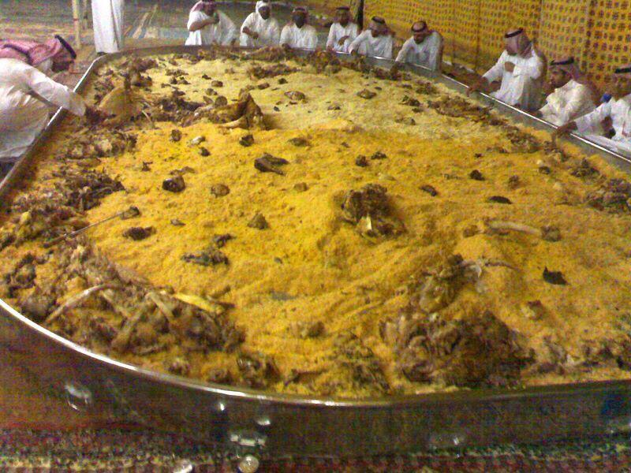
Complex Problem (WP)

Slide 30
Complex Problem
Need to think broadly and systematically and see the big picture
Difficult
Decision
Uncertain
Strategy
Confusing
Idea
Contentious
Product
Intractable
Change

Slide 31
Difficulty & Uncertainty
Complexity – the problem contains a large number of diverse, dynamic and interdependent elements
Measurement – it is difficult or practically unfeasible to get good qualitative data
Novelty – there is a new solution evolving or an innovative design is needed

Slide 32
Scientific/Technical Problems
can combine to form
A
Complex Problem

Slide 33
Limited Explanation, Prediction, Control
?
A limited number of features are captured by the Model
Operating with scare resources
Difficult to measure
Unbounded Systems, No Experiment
Complex causal Chains
Results in an educated guest
Explanation, Prediction, Control
f(x,y,z)
All the Salient features are captured by the Model
Operating with adequate resources
Measurable
Isolatable Systems, Controlled Experiment
Simple causal Chains
Results in a Covering Law
Complex
Technical

Slide 34
Characteristics
Technical Problems
Complex Problems
Isolatable boundable problem
Universally similar type
Stable and/or predictable problem parameters
Multiple low-risk experiments are possible
Limited set of alternative solutions
Involve few or homogeneous stakeholders
Single optimal and testable solutions
Single optimal solution can be clearly recognised
No definitive problem boundary
Relatively unique or unprecedented
Unstable and/or unpredictable problem parameters
Multiple experiments are not possible
No bounded set of alternative solutions
Multiple stakeholders with different views or interest
No single optimal and/or objectively testable solution
No clear stopping point

Slide 35
Complex Problems (Need High Taxonomy Level)
Complex Engineering Problems have characteristic WP1 and some or all of WP2 to WP7, EP1 and EP2, that can be resolved with in-depth forefront knowledge
WP1 | Depth of Knowledge required | Resolved with forefront in-depth engineering knowledge (WK3, WK4, WK5, WK6 or WK8) which allows a fundamentals-based, first principles analytical approach
WP2 | Range of conflicting requirements | Involve wide-ranging or conflicting technical, engineering and other issues.
WP3 | Depth of analysis required | Have no obvious solution and require abstract thinking, originality in analysis to formulate suitable models.
WP4 | Familiarity of issues | Involve infrequently encountered issues
WP5 | Extent of applicable codes | Beyond codes of practice
WP6 | Extent of stakeholder involvement and level of conflicting requirements | Involve diverse groups of stakeholders with widely varying needs.
WP7 | Interdependence | Are high level problems including many component parts or sub-problems.
EP1 | Consequences | Have significant consequences in a range of contexts.
EP2 | Judgement | Require judgement in decision making

Slide 36
Problem Oriented, Team-Based Project Work as a Learning/Teaching Device
Problem-oriented project-organized education deals with the solution of theoretical problems through the use of any relevant knowledge, whatever discipline the knowledge derives from. We are dealing with KNOW WHY (Research Problems).
In design-oriented project work, the students deal with KNOW HOW problems that can be solved by theories and knowledge they have acquired in their previous lectures. (Design Problems).

Slide 37
Complex Engineering Activities (Project based)
Preamble | Complex activities means (engineering) activities or projects that have some or all of the following characteristics listed below
Range of resources | Diverse resources (people, money, equipment, materials, information and technologies).
Level of interaction | Require resolution of significant problems arising from interactions between wide ranging or conflicting technical, engineering or other issues.
Innovation | Involve creative use of engineering principles and research-based knowledge in novel ways
Consequences to society and the environment | Have significant consequences in a range of contexts, characterised by difficulty of prediction and mitigation.
Familiarity | Can extend beyond previous experiences by applying principles-based approaches.

Slide 38
WA – WK – WP Relationships
WA1 – Engineering Knowledge
(Science, Mathematics & Engineering)
(WK1, WK2, WK3, WK4)
(know what)
WK1 - natural sciences (WA1)
WK2 - mathematics, numerical analysis,
statistics, computer and information science
(WA1)
to solve
Complex Engineering Problems
WK3 - engineering fundamentals (WA1)
WK4 - engineering specialist knowledge (WA1)
WP1 – Depth of Knowledge required:
Resolved with forefront in-depth
engineering knowledge
(WK3, WK4, WK5, WK6 or WK8)
which allows a fundamentals-based,
first principles analytical approach
WK5 - engineering design (know how)
WA3 - Design
WK6 - engineering practice (know how)
WA5 - Modern Tools
WK8 - research literature (know why)
WA4 - Investigation

Slide 39
to solve
Complex Engineering Problems
WK1 - natural sciences (WA1)
WK2 - mathematics, numerical analysis,
statistics, computer and information science (WA1)
WP1 – Depth of Knowledge required:
Resolved with forefront in-depth
engineering knowledge
(WK3, WK4, WK5, WK6 or WK8)
which allows a fundamentals-based,
first principles analytical approach
WK3 - engineering fundamentals (WA1)
WK4 - engineering specialist knowledge
(WA1)
WK5 - engineering design
WA3 - Design
WK6 - engineering practice
WA5 - Modern Tools
WP2 | Range of conflicting requirements
WP3 | Depth of analysis required
WP4 | Familiarity of issues
WP5 | Extent of applicable codes
WP6 | Extent of stakeholder involvement and level of conflicting requirements
WP7 | Interdependence
EP1 | Consequences
EP2 | Judgement
WK8 - research literature
WA4 - Investigation
Some or all
WP2 – WP7, EP1 & EP2

Slide 40
to solve
Complex Engineering Problems
WK1 - natural sciences (WA1)
WK2 - mathematics, numerical analysis,
statistics, computer and information science (WA1)
WP1 – Depth of Knowledge required:
Resolved with forefront in-depth
engineering knowledge
(WK3, WK4, WK5, WK6 or WK8)
which allows a fundamentals-based,
first principles analytical approach
WK3 - engineering fundamentals (WA1)
WK4 - engineering specialist knowledge
(WA1)
WK5 - engineering design
WA3 - Design
WK6 - engineering practice
WA5 - Modern Tools
WP2 | Range of conflicting requirements
WP3 | Depth of analysis required
WP4 | Familiarity of issues
WP5 | Extent of applicable codes
WP6 | Extent of stakeholder involvement and level of conflicting requirements
WP7 | Interdependence
EP1 | Consequences
EP2 | Judgement
WK8 - research literature
WA4 - Investigation
WK7 - engineering in society
WA6 - engineer & society
WA7 - environment & sustainability
WA8 - ethics
Breadth

Slide 41
WK1 - natural sciences (WA1)
Design Course
WK2 - mathematics, numerical analysis,
statistics, computer and information science (WA1)
WP1 – Depth of Knowledge required:
Resolved with forefront in-depth
engineering knowledge
(WK3, WK4, WK5, WK6 or WK8)
which allows a fundamentals-based,
first principles analytical approach
WK3 - engineering fundamentals (WA1)
WK4 - engineering specialist knowledge (WA1)
WK5 - engineering design
WA3 - Design
WK6 - engineering practice
WA5 - Modern Tools
WP2 | Range of conflicting requirements
WP3 | Depth of analysis required (WA2)
WP4 | Familiarity of issues
WP5 | Extent of applicable codes
WP6 | Extent of stakeholder involvement and level of conflicting requirements WK7 (WA6, WA7, WA8)
WP7 | Interdependence
EP1 | Consequences
EP2 | Judgement
WK8 - research literature
WA4 - Investigation
WK7 - engineering in society
WA6 - engineer & society
WA7 - environment & sustainability
WA8 - ethics
WA2 - Problem Analysis
WA9 - Individual and Team Work
WA10 - Communication
WA11 - Project Management and Finance
WA12 - Life-long Learning

Slide 42
Example 1: Complex Problem Solving
Two villages in Timbuktu are separated from each other by a valley, at its deepest section about 30 metres.
The valley is dry all the year around, except for the four months, from October to December each year, where torrential rainfall can flood major parts of the valley to a depth of over 12 metres in some site.
The soil is generally lateritic with firm bedrock underneath. A bridge connecting the two villages is in a state of disrepair and has to be replaced.
Write a project brief on how would you approach to design for the replacement bridge.
You are limited to the use of locally available building materials.
Heavy equipment is not available for the construction.

Slide 43
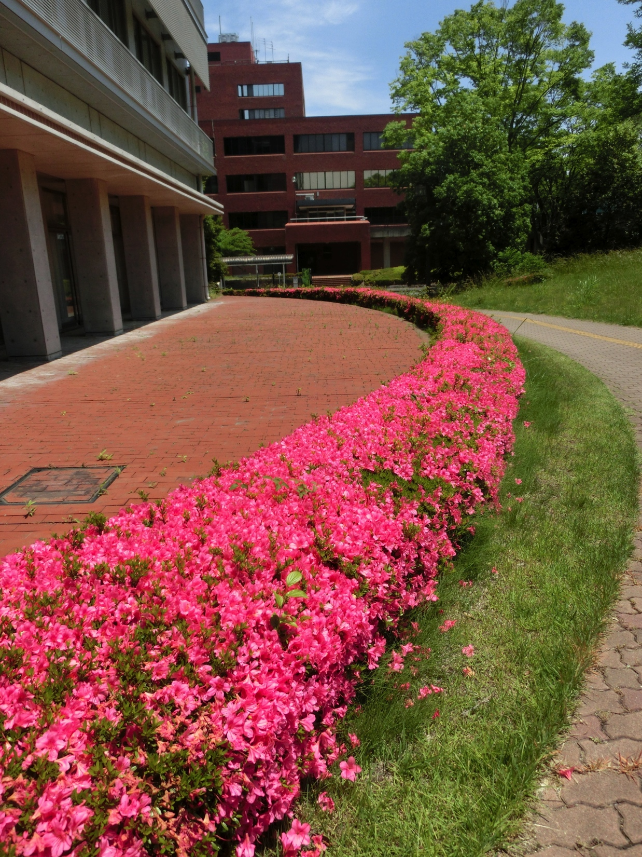
Aspects
Economics
Social
Environment
Ethics
Management
Technology
Analysis
Evaluation

Slide 44
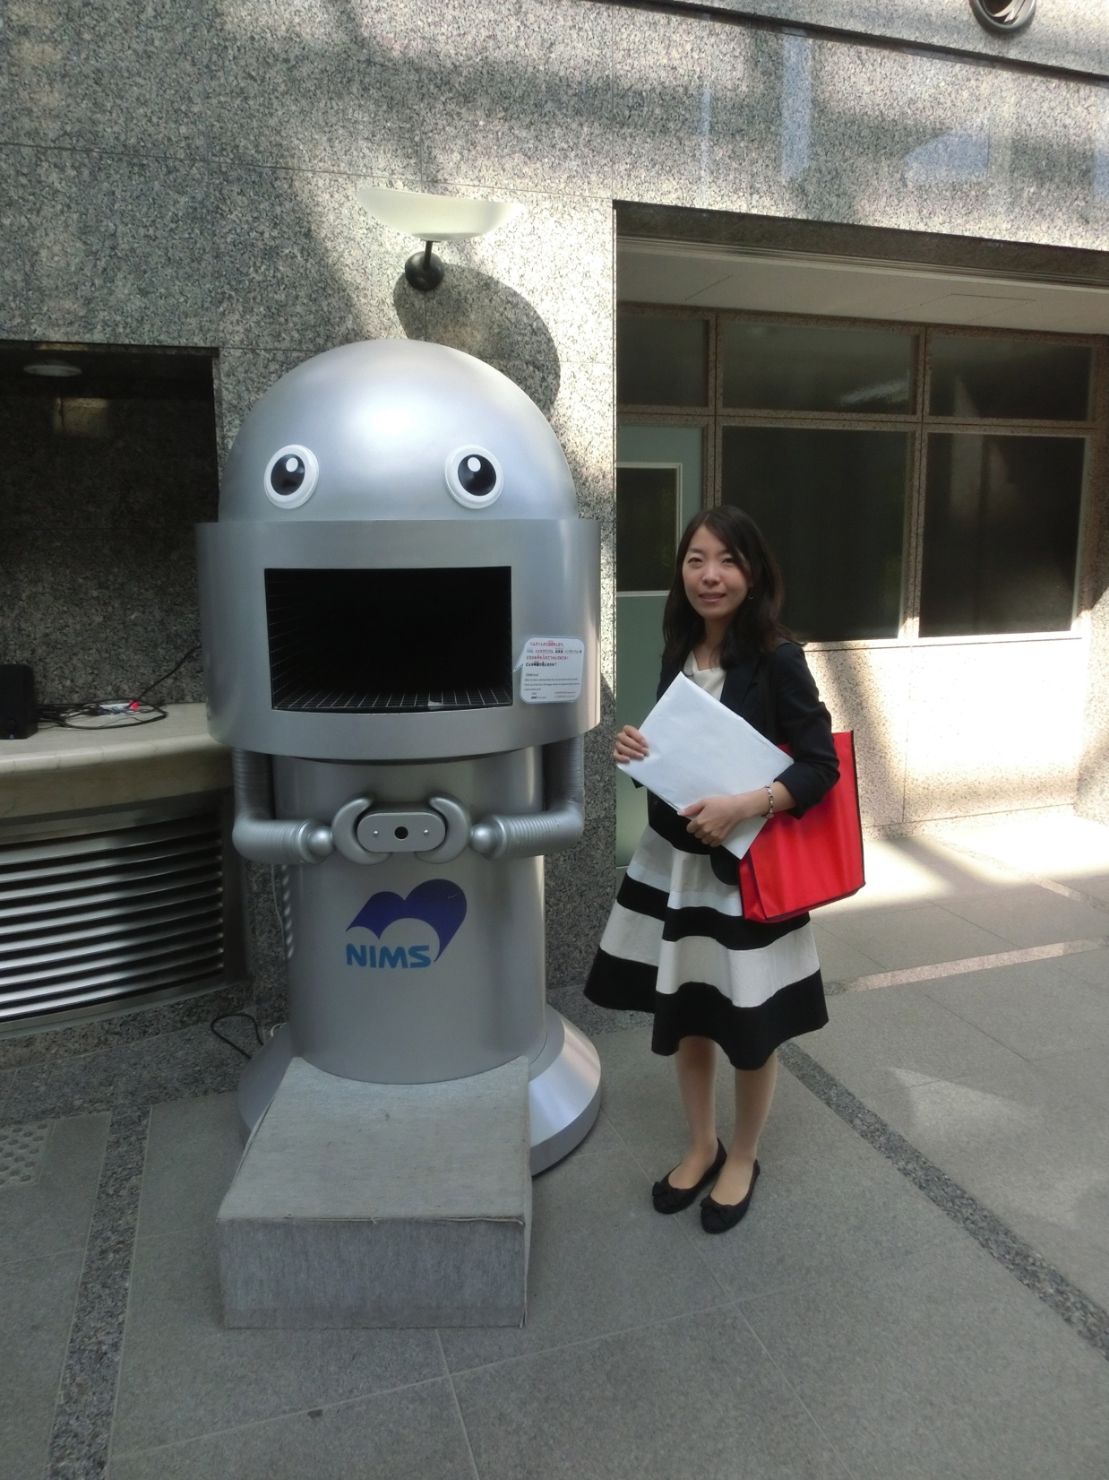
Thinking
Site condition
Weather
Available technology
Building materials
Design
Costing
Scheduling

Slide 45
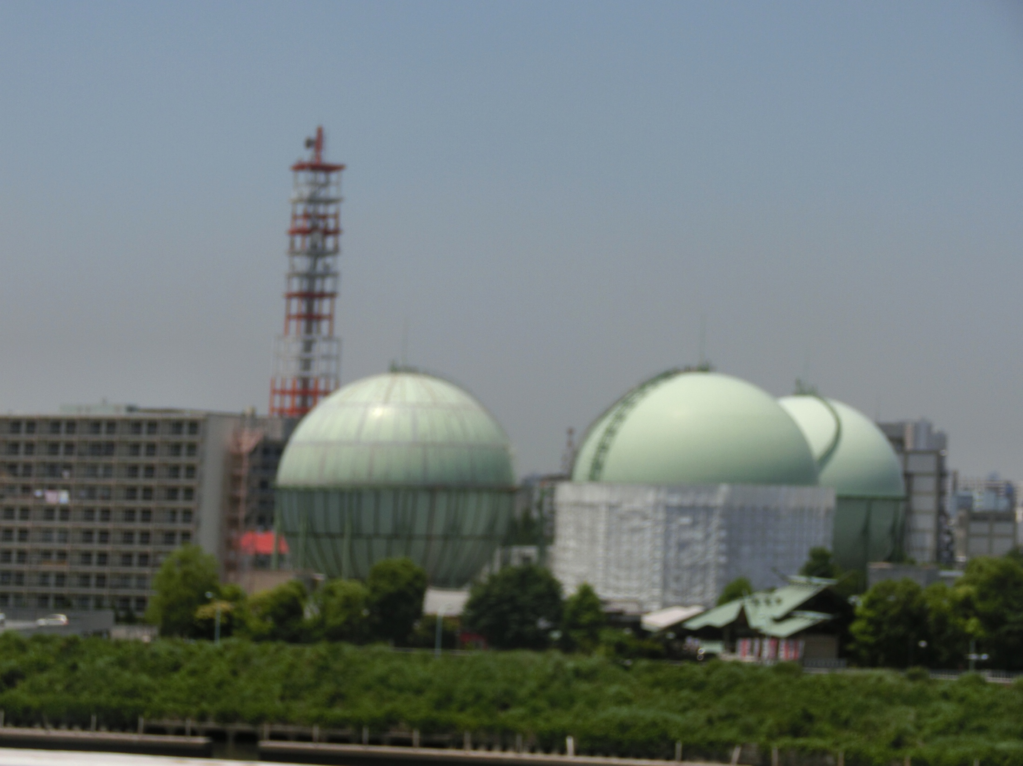
Solutions?
Problem solving skills
Formulate the problem
Literature
Experiment?

Slide 46
Assessment
Report – style and content (flow)
Display – attractive ?
Viva / Articulation
Teamwork
Management – scheduling

Slide 47
Example 2: Complex Problem Solving
River
Spring
Sandy soil
Fissured Rocks
Clayey soil
Igneous rock
Groundwater flow

Slide 48
How does complexity relates to curriculum?
General Subjects
Industrial Placement
Core & Specialist (Engineering) Subjects – Complex Problem Solving
Elective Subjects – Complex Problem Solving
Design Project – Complex Engineering Activities
Final Year Project – Complex Problem Solving

Slide 49
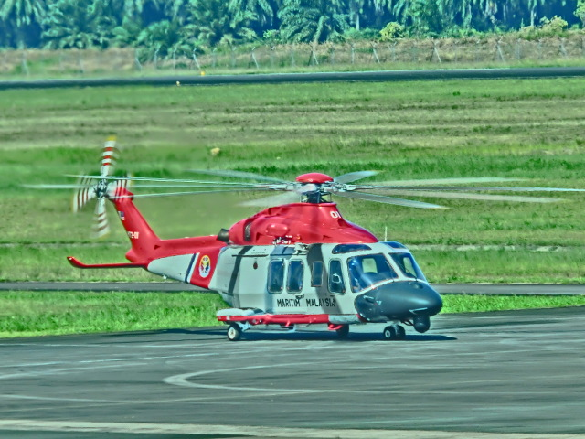
Closing Remarks

Slide 50
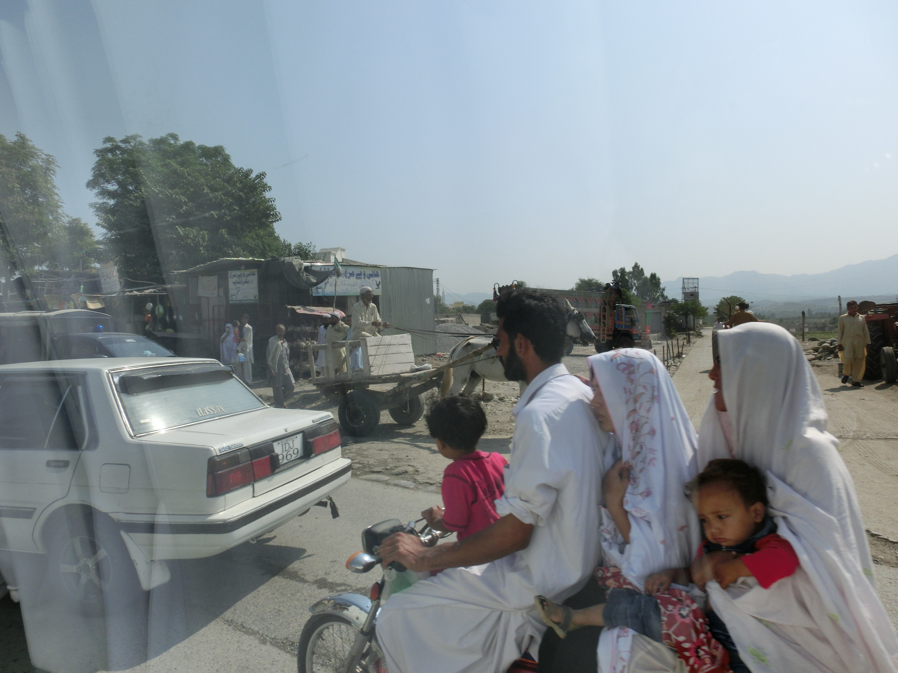
Thank You

Slide 51
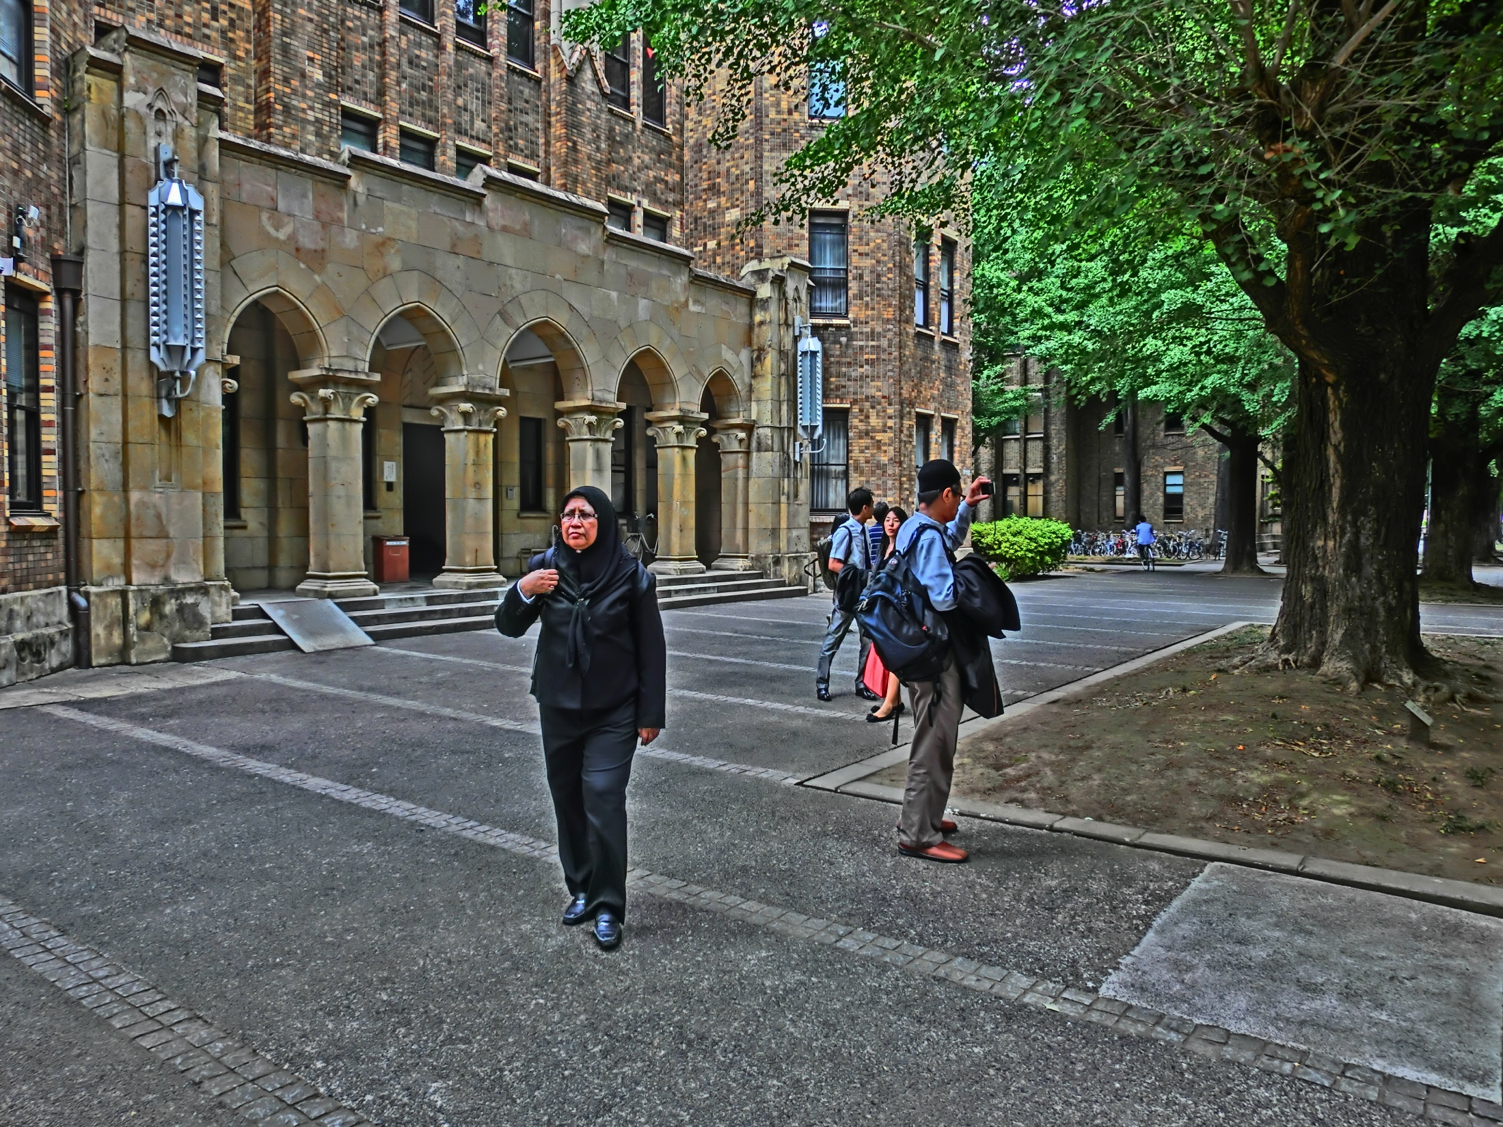
Appendix

Slide 52
Complex Problem Solving (CPS)
Dynamic, because early actions determine the environment in which subsequent decision must be made, and features of the task environment may change independently of the solver’s actions;
Time- dependent, because decisions must be made at the correct moment in relation to environmental demands;
Complex, in the sense that most variables are not related to each other in a one-to-one manner

Slide 53
Microworld CPS Model
The problem requires not one decision, but a long series, in which early decisions condition later ones.
For a task that is changing continuously, the same action can be definitive at moment t1 and useless at moment t2.
Include novel solutions to an old dilemma in general science (external validity vs. experimental control)

Slide 54
Expert-novice CPS Model
Expert-novice approach most of the time produces conclusions that are crystal-clear.
It almost guarantees statistically significant results, because the groups compared (expert and novices) are very different and tend to perform very differently when confronted with similar experimental situations (Sternberg 1995).

Slide 55
Naturalistic decision making (NDM)
Naturalistic decision making (NDM) (e.g., Zsambok and Klein 1997, Salas and Klein 2001)
‘real-world’ task
Example interviewing firefighters after putting out a fire or a surgeon after she has decided in real time what to do with a patient.

Slide 56
Dynamic decision making DDM
Dynamic decision making (DDM) (Brehmer 1992, Sterman 1994).
Discrete dynamic decision tasks that change only when the participant introduces a new set of inputs.
Variables like time pressure have been successfully integrated in models like Busemeyer and Townsend’s (1993) decision field theory

Slide 57
Implicit learning in system control
This tradition has used tasks like the sugar factory (Berry and Broadbent 1984) or the transportation task (Broadbent et al. 1986), that are governed by comparatively simple equations.
The theorization and computational modeling in this branch of CPS are extremely rich. Models are based on exemplar learning, rule learning, and both (e.g., Dienes and Fahey 1995, Gibson et al. 1997, Lebiere et al. 1998).

Slide 58
European complex problem solving (CPS)
Initiated by Dörner (Dörner and Scholkopf 1991, Dörner and Wearing 1995)
A large number of tasks that have been considered complex problem solving are nowadays affordable for theory development and computer modeling (e.g. Putz-Osterloh 1993, Vollmeyer et al. 1996, Burns and Vollmeyer 2002, Schoppek 2002)
Transport real-life complexity to the lab in a way that can be partly controlled

Slide 59
Time related
Time variant – time invariant (dynamic vs. static systems)
Continuous time – discrete time.
Degree of time pressure – decision has to be made quickly

Slide 60
Variable related
Number and type (discrete/continuous) of variables
Number and pattern of relationships between variables
Non-Linear - Linear

Slide 61
System behaviour related
Opaque - transparent.
Stochastic - deterministic
Delayed feedback - immediate feedback.

Slide 62
Delivery
Knowledge-lean vs. knowledge-intensive
Skill based vs planning based (reactive vs predictive
Learning vs. no learning during problem solving
Understanding-based vs. search-based problems
Ill-defined vs. well-defined

Slide 63
Conclusion
Problem solving has been traditionally a task-centered field. VanLehn (1989) think that ‘task’ and ‘problem’ are virtually synonymous.

Slide 65
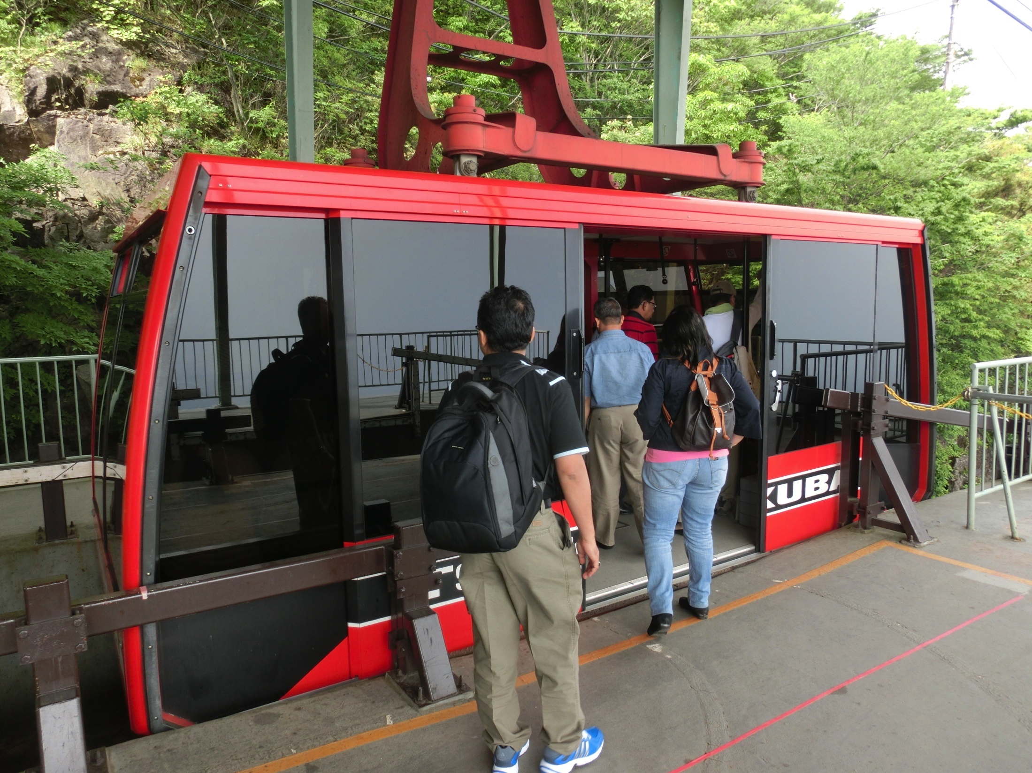
The author would like to thank the contributors of the clip arts used in this presentation

